Slide 1

Aswathy M A

Slide 2
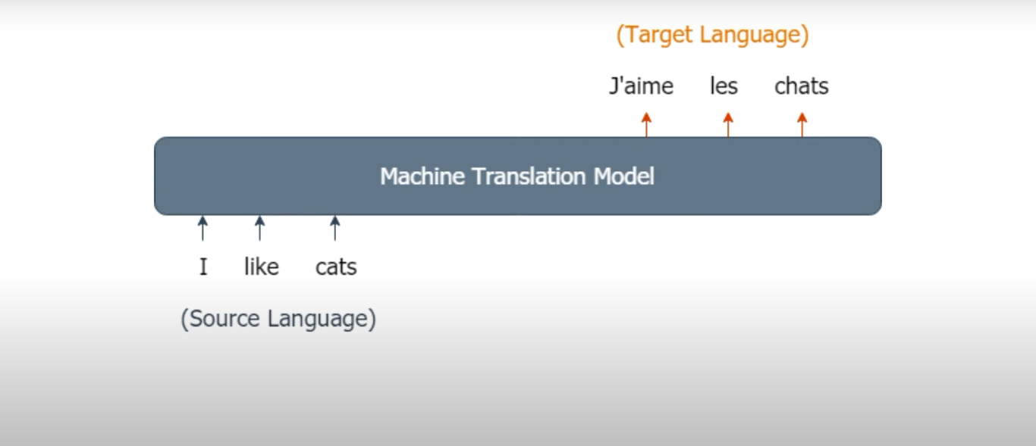
Encoder Decoder Model

Slide 3
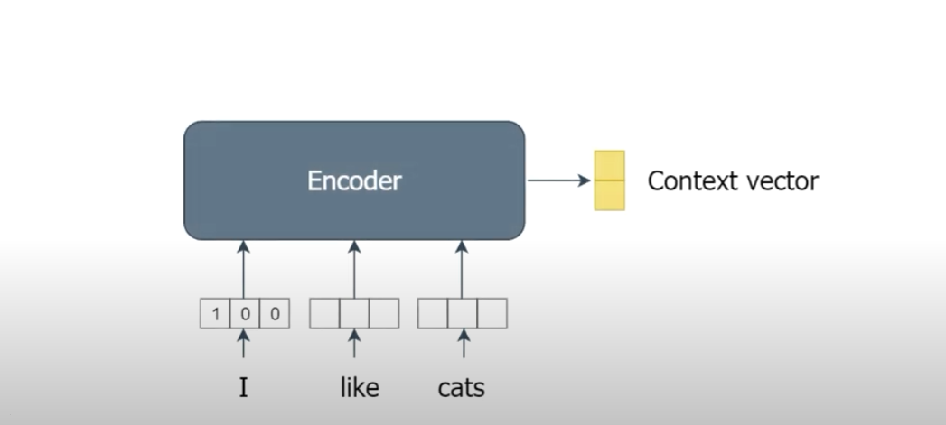
Encoder

Slide 4
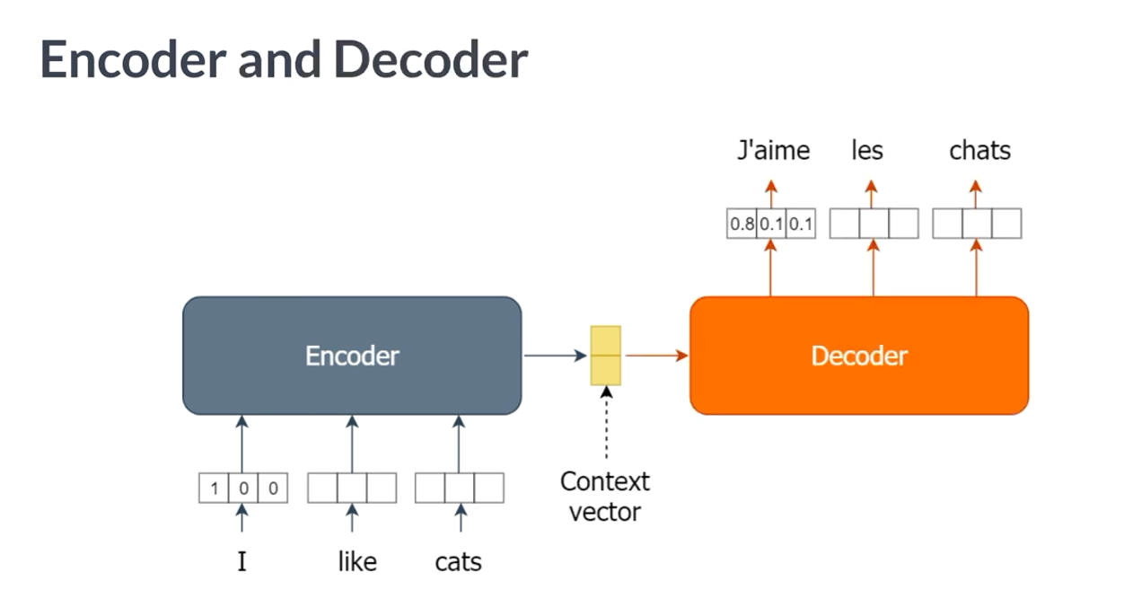

Slide 5
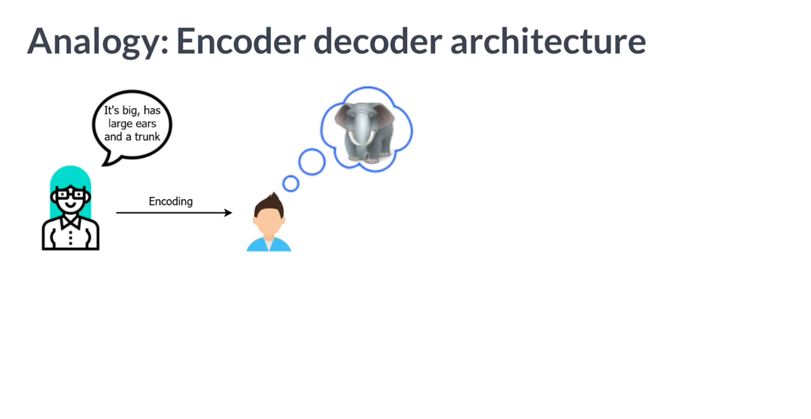

Slide 6
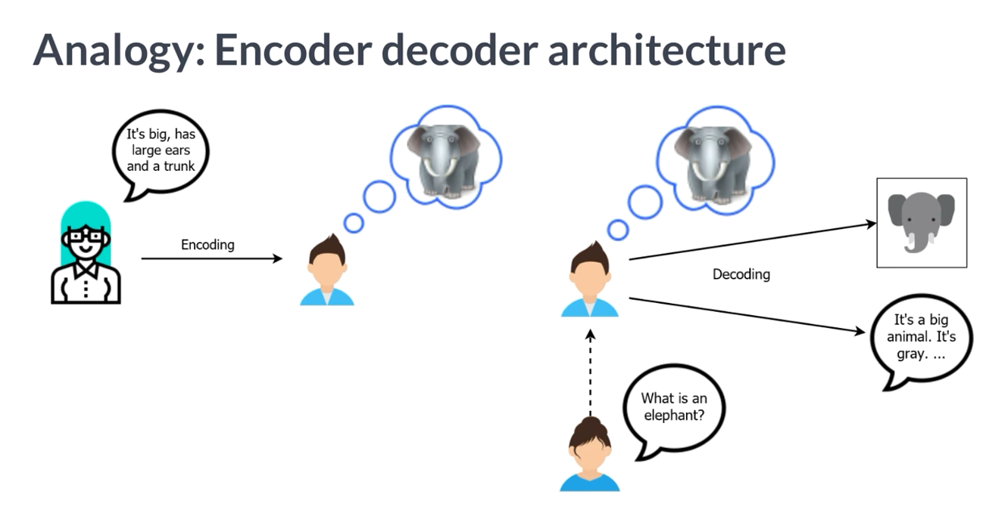

Slide 7
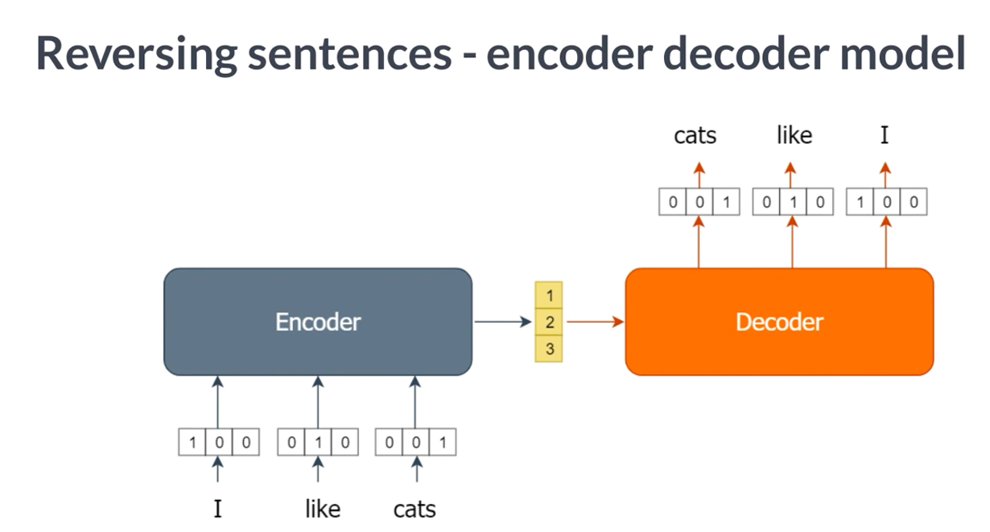

Slide 8
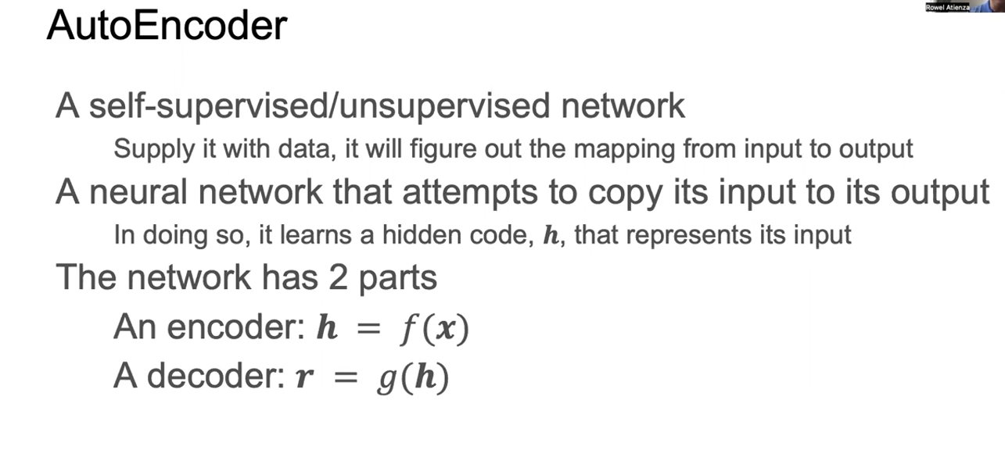

Slide 9
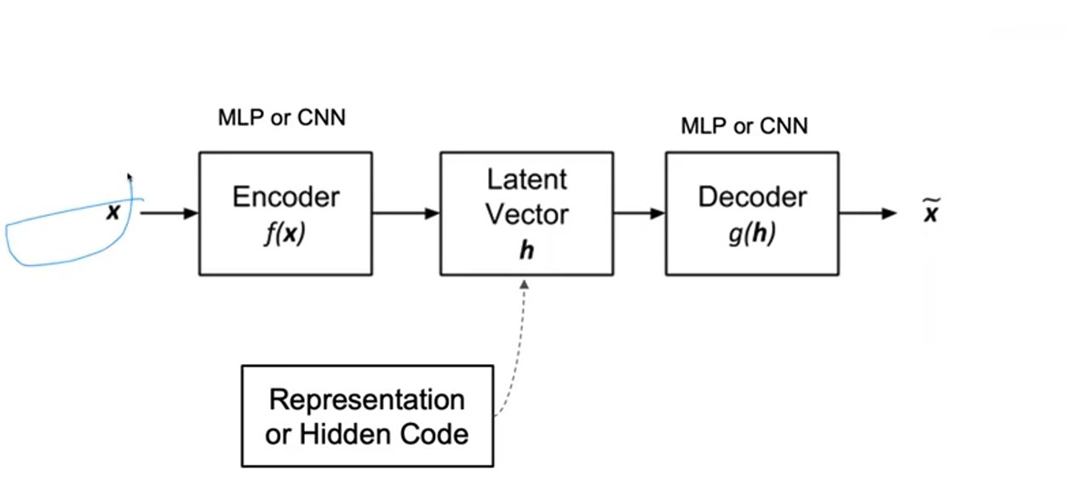

Slide 10
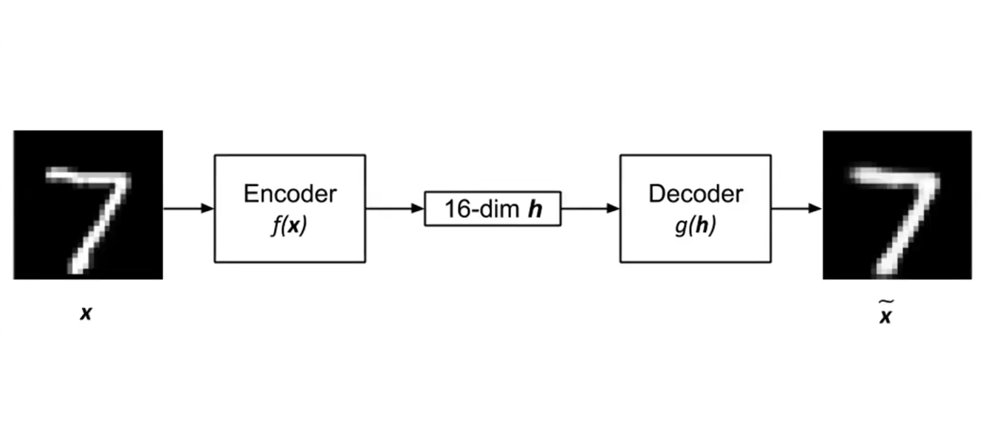

Slide 11
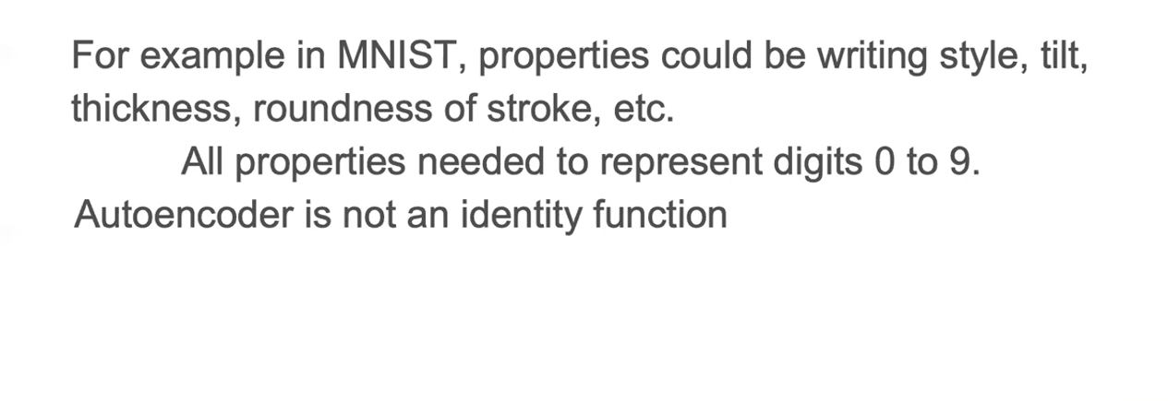

Slide 12
Autoencoders
Autoencoders are neural network-based models that are used for unsupervised learning purposes to discover underlying correlations among data and represent data in a smaller dimension.
The autoencoders frame unsupervised learning problems as supervised learning pro
The input is squeezed down to a lower encoded representation using an encoder network, then a decoder network decodes the encoding to recreate back the input.

Slide 13
An Autoencoder has the following parts:
Encoder: The encoder is the part of the network which takes in the input and produces a lower Dimensional encoding
Bottleneck: It is the lower dimensional hidden layer where the encoding is produced. The bottleneck layer has a lower number of nodes and the number of nodes in the bottleneck layer also gives the dimension of the encoding of the input.
Decoder: The decoder takes in the encoding and recreates back the input.

Slide 14
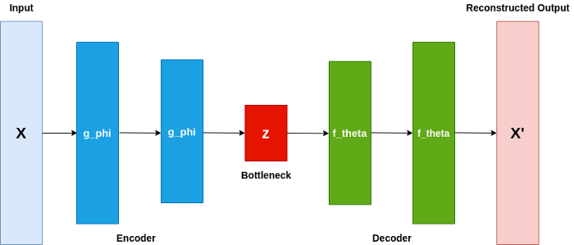

Slide 15
The bottleneck layer is the lower dimension layer.
In the diagram, we have the neural networks encoder and decoder.
Phi and Theta are the representing parameters of the encoder and decoder respectively.
The target of this model is such that the Input is equivalent to the Reconstructed output.

Slide 16
To achieve this we minimize a loss function named Reconstruction Loss.
Basically, Reconstruction Loss is given by the error between the input and the reconstructed output.
It is usually given by the Mean Square error or Binary Crossentropy between the input and reconstructed output.
Binary Crossentropy is used if the data is binary.

Slide 17
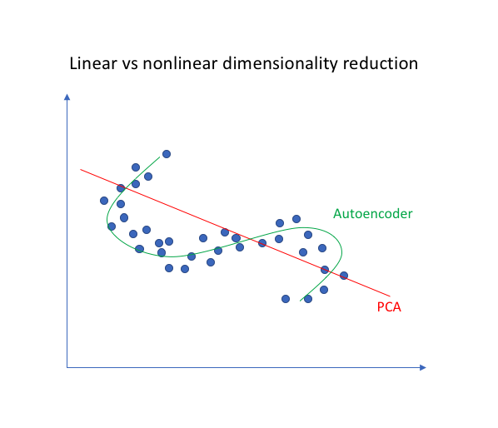
Important Point
The reason behind using an autoencoder is that we want to understand and represent only the deep correlations and relationships among data.

Slide 18
Applications of autoencoders:
Autoencoders are used largely for anomaly detection: As we know, autoencoders create encodings that basically captures the relationship among data. Now, if we train our autoencoder on a particular dataset, the encoder and decoder parameters will be trained to represent the relationships on the datasets the best way. Thus, will be able to recreate any data given from that kind of dataset in the best way. So, if data from that particular dataset is sent through the autoencoder, the reconstruction error is less. But if some other kind of data is sent through the autoencoder it will generate a huge reconstruction error. If we are able to apply a correct cutoff we will be able to create an anomaly detector.

Slide 19
Applications of autoencoders:
Autoencoders are used for Noise Removal: If we can pass the noisy data as input and clean data as output and train an autoencoder on such given data pairs, trained Autoencoders can be highly useful for noise removal. This is because noise points usually do not have any correlations. Now, as the autoencoders need to represent the data in the lowest dimensions, the encodings usually have only the important relations there exists, rejecting the random ones. So, the decoded data coming out as output of an autoencoder is free of all the extra relations and hence the noise.

Slide 20
Applications of autoencoders:
Autoencoders as Generative models: Before the GAN’s came into existence, Autoencoders were used as generative models. One of the modified approaches of autoencoders, variational autoencoders are used for generative purposes.

Slide 21
Denoising Autoencoders (DAEs)
The DAE is designed to learn the innate structure (i.e. summary) of data.
The DAE, however, goes an extra step.
It attempts to divine this innate structure, and do so in such a thorough manner that, when faced with a corrupted (or noisy) version of the data, it can eliminate most, and ideally, all, of the corruption in the data.

Slide 22
By noise, we mean artefacts in our data that may be due to:
Malfunctioning sensors
Quantization
Damage over time (e.g. old images)

Slide 23
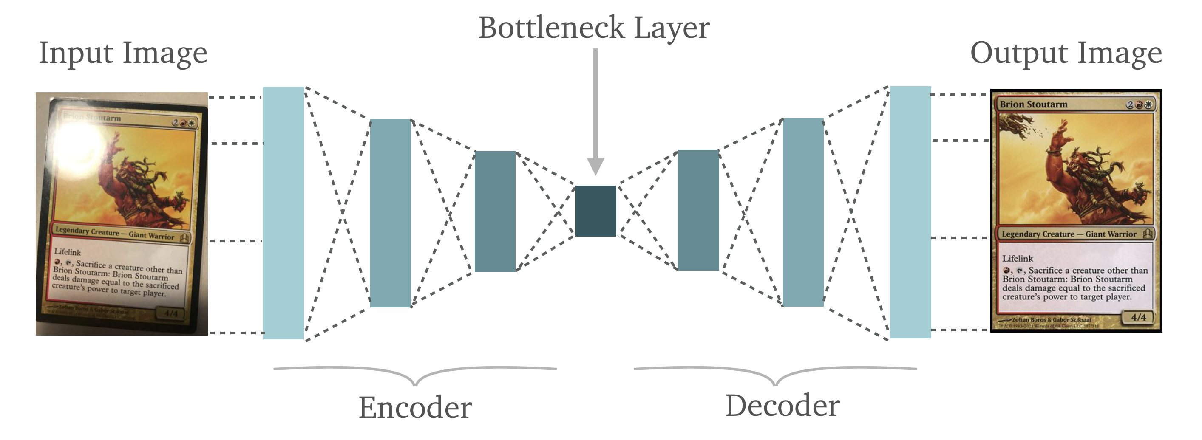
This denoising/reconstruction process is illustrated via Figure:

Slide 24
The input data (a corrupted version of the actual data) is passed into the Encoder to produce the encoding (also embedding).
This embedding is then passed into the Decoder, which reconstructs the data via the embedding.
Note the upper left corners of both the input image and the reconstructed image depicted in figure.
This is a very good illustration of what a DAE is capable of.

